Slide 1

Cambourne Village: a major survey project by trics
Alex Jack, east sussex county council
Notes:
In this presentation I am going to talk about the major TRICS survey project, a multi-modal survey at a large, new mixed use settlement. I will take you through the background of this project and the development being surveyed, as well as the technical elements of the project and how the surveys were delivered. We will then also cover some of the very initial findings of the survey.

Slide 2
Cambourne village: a major survey project by trics
What and where is Cambourne Village?
The demand for information on new settlements
Cambourne’s layout and infrastructure
Cambourne West’s travel plans & monitoring reports
The concept of a TRICS survey at Cambourne
Carrying out the survey
Initial findings
Notes:
So, the structure of my session is as follows. We are going to first have a look at the subject of this survey, which is Cambourne Village in Cambridgeshire. I will take you through a summary of where the development is, and will then speak a bit about the demand for survey data at such developments. Then I will summarise the layout and infrastructure of the development, before giving some background to part of the development that has been subject to a travel plan and subsequent monitoring. I will also speak a bit about the concept of a TRICS survey at the site and the background to our decision to go ahead with this challenging survey. Then there will be a little bit on how the survey was carried out and finally some of the initial findings that we have seen.

Slide 3
What and where is Cambourne village?
A new, free standing community in Cambridgeshire.
400 hectares, 4,250 new homes (2,975 private & 1,275 affordable).
Other mixed use including commercial, retail, schools, hotel, sports centre, etc.
Construction commenced in 1998, final completion due in 2020.
Marketed as “a thriving, well balanced and sustainable community”.
Comprises three villages: Great Cambourne, Lower Cambourne, Upper Cambourne
Notes:
So what and where is Cambourne Village? Well, it is a substantial free standing community in Cambridgeshire, with it being 400 hectares in size. It includes 4,250 new homes, split between 2,975 privately owned dwellings and 1,275 affordable units. As well as this, there is a mixture of various type of non-residential development within the site, including retail, schools, a hotel, a sports centre, a community centre and other uses. Construction on the site commenced back in 1998, with final completion of all construction due in 2020. As things currently stand the vast majority of the site is completed, certainly to the extent that a TRICS survey covering the whole development is now feasible and practical. The village is marketed as “a thriving, well balanced and sustainable community”, and it comprises three parts, these being Great Cambourne, Lower Cambourne and Upper Cambourne.

Slide 4
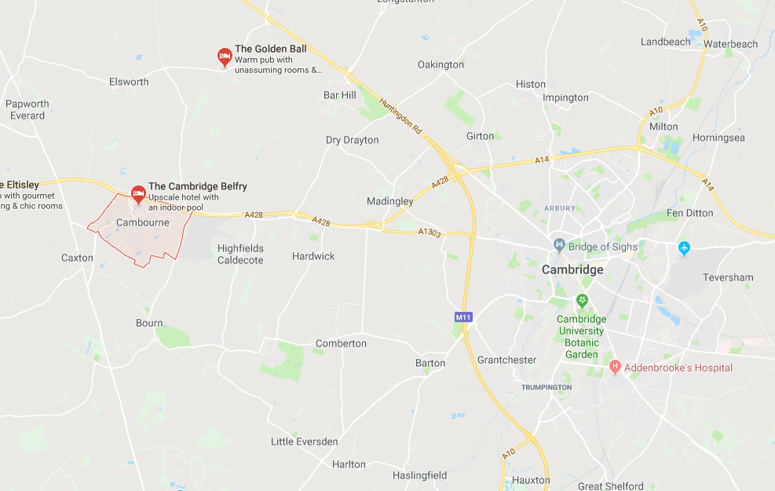
CAMBOURNE VILLAGE: LOCATION
Notes:
Here we have a map of where the site is located in relation to the nearest major urban settlement (Cambridge). It is located from the north off the A428, which heads west towards the junction with the north/south A1, and east towards the junction with the A10 and Cambridge. It is also accessed by vehicle to the south via the A1198. At the site’s eastern boundary is Bourn Airport, with other directions being mainly open land, making this a true free standing settlement.

Slide 5
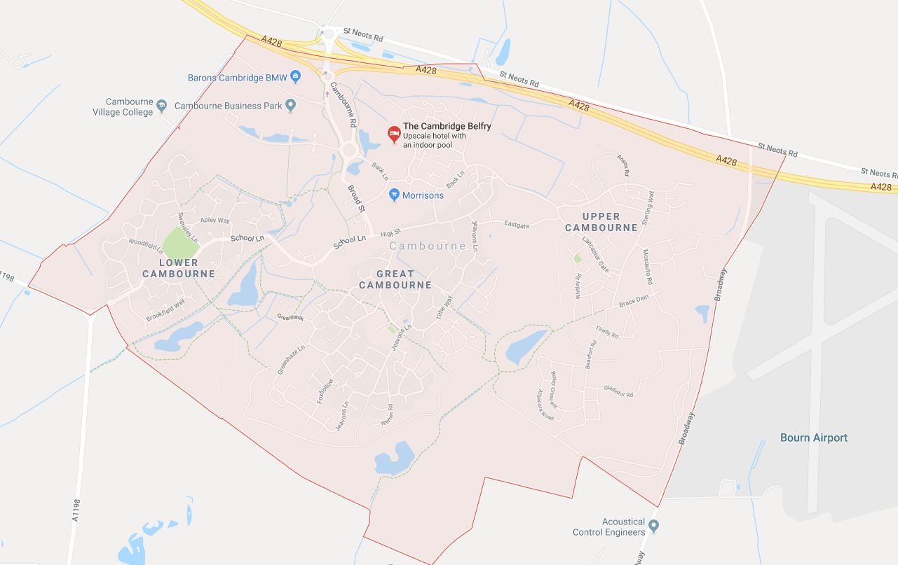
CAMBOURNE VILLAGE: LOCATION
Notes:
Zooming in a bit, we can see the main structure of Cambourne here. As stated before, we have Lower Cambourne to the west, Great Cambourne in the centre (which is the largest of the three village areas), and Upper Cambourne to the east. We can also see in greater detail the single vehicular route which passes through the site, labelled School Lane, Broad Street and Cambourne Road. As you can see, residents of each of the sub-villages can easily reach the other parts of the overall development.

Slide 6
THE DEMAND FOR INFORMATION ON NEW SETTLEMENTS
TRICS users (and professionals in the transport planning industry general) have for some time been requesting monitoring data on new settlements.
An issue has always been waiting for a suitable site to be developed.
How “sustainable” are such developments?
Does the reality of trip generation etc match up with the theory?
The question of “internalisation”.
Notes:
There has up until now been no real hard trip generation and modal split data on free standing settlements such as Cambourne Village. This is a subject that TRICS users have asked us about for some time, but until recently we were unable to come across a site suitable for such a study. The biggest question that is asked is how sustainable are these developments? They are of course marketed as being sustainable developments that are designed to minimise external trip generation, but we have always wondered what the reality of such developments might be when compared to the theory. Do such settlements assist in achieving sustainable transport? And what of the question of internalisation? Would more people live and work within the settlement and therefore reduce the need for as many external trips? The one thing that could start to address these long-standing questions is of course a comprehensive, targeted survey at a surveyable and developed site.

Slide 7
NEW SETTLEMENTS: THE VIEW OF TRICS
TRICS Consortium Limited is committed to a policy of responding to user needs.
A major survey project at a new settlement had been a consideration since the company was formed.
We waited until a suitable development had been constructed and was considered to be “surveyable”.
Our data collection methodology allows a flexible approach, which in turn allows us to ask some of the questions of transport professionals, and to deliver some answers.
Once a potential location was found we decided to take a closer look.
Notes:
Here at TRICS, we have always followed the principle of responding to our user’s needs, especially when it comes to the annual User Survey, but also through direct communication. Since TRICS Consortium Limited was formed in January 2015, a major survey project like this had always been something discussed by the board. We looked at a number of potential sites for such a study, but up until recently we found that the sites were at an early stage of construction. Also, it is important to find a site that is itself “surveyable”, in that the number of overall accesses are manageable in terms of delivering a TRICS survey. However, our data collection methodology is flexible and allows us (through our experience) to adapt and tailor our approach to any practical scenario. So we found Cambourne, which seemed promising as a survey candidate, and we decided to take a further look.

Slide 8
CAMBOURNE VILLAGE’S INFRASTRUCTURE
Site consists of residential plus a mix of other uses.
Cyclepaths, bridleways and footpaths all present within the site (mostly shared use).
Three bus routes stop within the site.
Nearest rail stations are St Neots (west), Cambridge (east) and Shepreth/Foxton (south-east).
Two vehicle access points (northern and southern boundaries of site).
Notes:
We looked at the site and found it to be quite suitable in terms of the type of development we were looking for. The site consists of large residential areas plus a mix of other uses (as mentioned earlier). There are mostly shared cycleways, footpaths and bridleways within the site, with are largely gravel-based off-road and connect the three sub-villages together along with the local roads that connect them. Three bus routes pass through the site and stop at various points within it, one of which includes a circular route in the Great Cambourne part. The development does not have a train station. The nearest stations are St Neots (to the west), Cambridge (to the east) and Shepreth/Foxton stations to the south-east, all significant distances away. And in terms of vehicular access, as mentioned before there are two accesses, one at the southern boundary and the other at the northern boundary.

Slide 9
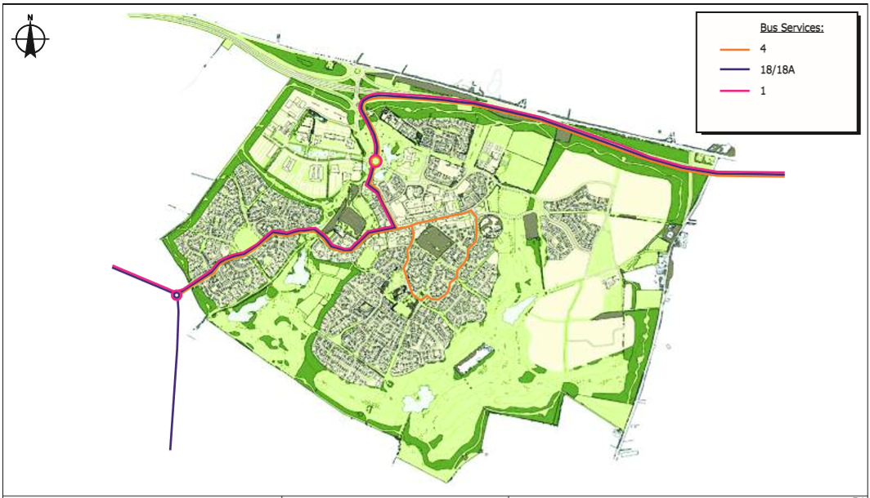
CAMBOURNE: BUS SERVICES & ROAD THROUGH-ROUTE
Notes:
Here is a plan of the three bus routes that serve the site. All routes head through the site using the main route north to south (and vice versa), with route number 4 also operating a circular service within Greater Cambourne as we can see in the middle of the image in orange. This image of course also shows the southern and northern access points. It was clear at an early stage of looking at the site that we would need to incorporate an ANPR element into the study to identify and exclude through-trips.

Slide 10
TRAVEL PLANS & MONITORING REPORTS: CAMBOURNE WEST
Original planning consent did not require a travel plan. However, a section of Cambourne Village (within Cambourne West) has been subject to travel plans and monitoring.
It was a requirement for household surveys to be undertaken within this part of the development.
Known as “Cambourne 950”, the first travel plan was produced in August 2011.
This was followed by a baseline travel plan monitoring report in January 2015.
This was subsequently followed by a Year 2 monitoring report in May 2016.
Notes:
The original planning consent for Cambourne did not require a travel plan as part of conditions. However, a section of the development that was subject to a separate proposal (within Cambourne West) was subject to such planning conditions, and as a result a travel plan exists for this part of the site, which has been subject to monitoring surveys. These were focused on residential travel habits, and the surveys took place in the form of residential household questionnaires. Known as “Cambourne 950”, the first travel plan of this part of the development was produced in August 2011. This was followed by a baseline travel plan monitoring report in January 2015, and then by a Year 2 monitoring report in May 2016.

Slide 11
TRAVEL PLAN OVERVIEW
Ultimate aim of the travel plan is to constrain the level of single occupancy vehicle trips and to encourage more sustainable modes of travel.
Objectives consist of the following:
  Address residents needs for access to a full range of local facilities.
  Reduce traffic generation.
  Encourage travel to and from the site to use car share, cycling, walking and public transport.
  Promote healthy lifestyles and sustainable, vibrant local communities.
  Encourage good urban design principles that open up the permeability of the development for walking and cycling.
Notes:
Without going into great detail about the travel plan for this western part of the site, I can provide a basic summary of the key points. The ultimate aim of the travel plan is to constrain the level of single occupancy vehicle trips and to encourage more sustainable modes of travel. The travel plan objectives can be summarised as follows. 1) Address residents needs for access to a full range of local facilities.
2) Reduce traffic generation.
3) Encourage travel to and from the site to use car share, cycling, walking and public transport.
4) Promote healthy lifestyles and sustainable, vibrant local communities.
5) Encourage good urban design principles that open up the permeability of the development for walking and cycling.

Slide 12
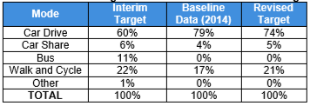
TRAVEL PLAN: BASELINE & TARGETS
Initial travel plan finalised prior to the occupation of the development.
Interim data based on existing travel patterns of residents.
Updated following baseline surveys of 2014.
Revised mode targets subsequently revised.
Notes:
The initial travel plan was finalised prior to the occupation of the development. Because of this, there needed to be some interim mode split targets, which was obtained using existing travel patterns of residents who were there prior to the new development being constructed. A baseline survey was then undertaken in 2014, from which revised mode split targets were produced, which can be seen in the table displayed.

Slide 13
SUMMARY OF TRAVEL PLAN MEASURES
Integrate the site with existing communities and employment areas by non-car modes.
Prioritise movement within the development for pedestrians, cycles and where appropriate, public transport.
Promote public transport, cycling and pedestrian information through marketing.
Provide a Travel Information Welcome Pack.
Set up a travel information website.
Ensure service information is provided in the sales office and at bus stops.
Notes:
On these next two slides we can summarise the travel plan measures that were or are to be implemented.
Integrate the site with existing communities and employment areas by non-car modes.
Prioritise movement within the development for pedestrians, cycles and where appropriate, public transport.
Promote public transport, cycling and pedestrian information through marketing.
Provide a Travel Information Welcome Pack.
Set up a travel information website.
Ensure service information is provided in the sales office at bus stops.

Slide 14
SUMMARY OF TRAVEL PLAN MEASURES
Seek to secure discounts with local cycle shops.
Investigate the feasibility of setting up a Bicycle User Group.
Approach car club companies to establish a service at the site and provide a space on site.
Provide safe and secure cycle parking facilities at key locations within the development.
Provide a bus route through the proposed site to ensure that a high proportion of the new development lies within a 400 metre walk of a bus stop.
Notes:
7) Seek to secure discounts with local cycle shops.
8) Investigate the feasibility of setting up a Bicycle User Group.
9) Approach car club companies to establish a service at the site and provide a space on site.
10) Provide safe and secure cycle parking facilities at key locations within the development.
11) Provide a bus route through the proposed site to ensure that a high proportion of the new development lies within a 400 metre walk of a bus stop.

Slide 15
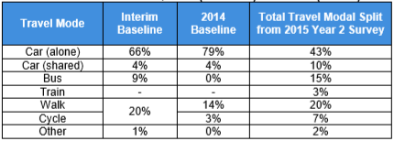
CAMBOURNE WEST YEAR 2 MONITORING SURVEY FINDINGS
Household questionnaires distributed to 580 occupied units, with 100 returns (17.4% response rate).
Significant reduction in SOV trips.
All other mode shares increased since the baseline survey was undertaken.
Notes:
The next monitoring survey that took place was the Year 2 survey in 2015. Household questionnaires were distributed to 580 occupied dwellings, with there being 100 returns (a response rate of 17.4% which is actually quite good for this type of survey format). This time it was found that, with a bigger number of responses, there was a significant reduction in SOV trips by residents, with all other mode shares being increased since the baseline survey was undertaken.

Slide 16
THE CONCEPT OF A TRICS SURVEY AT CAMBOURNE
In 2015 it was decided to investigate the possibility of a multi-modal TRICS survey at a new settlement.
In 2016 the Cambourne Village development was identified as a potential site, so discussions commenced with local authorities.
The survey would differ from the household questionnaire approach undertaken as part of travel plan monitoring. Instead, all inbound and outbound trips would be recorded (as is standard with TRICS), covering the whole of the Cambourne Village development.
The TRICS board spent time discussing what additional survey requirements there would be.
It was decided that identifying and quantifying internalisation (by surveying a number of key non-residential developments within the overall site) would be of great benefit to our users.
The aim is to provide a template methodology for future surveys at other new settlements.
Notes:
So having provided a brief summary of the site, its infrastructure and the travel plan that applies to part of the development, we now look at how TRICS approached the idea of a fully-inclusive survey covering the whole development. As discussed earlier, we were always looking for a suitable since 2015, and in 2016 we found what appeared to be a good candidate in Cambourne village. It was decided by the board to get in touch with the local authorities that covered the area, and so representatives from the board became involved in discussions. It was clear that the TRICS survey would differ significantly from the previous household questionnaires that had been undertaken in Cambourne West as part of travel plan monitoring. Instead, we would look to survey all trips in and out of the development throughout a whole day period (0700-2100). The TRICS board spent some time discussing what other requirements there would be, as it was clear that a “standard” multi-modal TRICS count would not answer some of the more pressing questions there were about new settlements. It was decided that the question of internalisation was very important, and it was decided that tackling this by surveying internal developments within the overall site on the same day as the greater Cambourne survey would deliver what we needed. And we were also aware of the fact that we would be looking at creating a template methodology for other future surveys at similar sites.

Slide 17
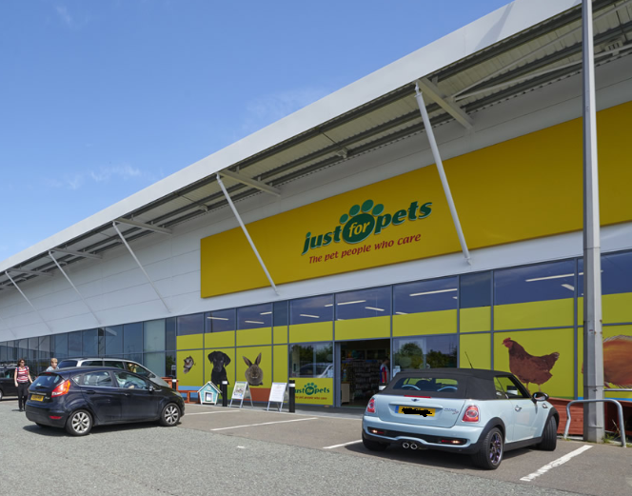
THE TRICS SURVEY: INTERNALISATION
Prior to the final go-ahead for a site visit and production of survey specifications, the TRICS board discussed in detail what would be required in terms of the study of internalisation.
It was decided to split internal and external trips by resident of Cambourne, employee of Cambourne, visitors to Cambourne, and people who were both residents AND employees of Cambourne.
Notes:
We needed to make sure that we go the approach right, as we only had one shot at the survey and getting the results that were most needed. So, prior to site visits being undertaken, the TRICS board discussed the detail of how we would tackle the question of internalisation, the split between people visiting elements of the site from within and from outside the greater Cambourne Village site. It was decided to split trips (by mode) inbound and outbound by a number of trip “types”. These were to be split as follows:
Resident of Cambourne
Employee of Cambourne
Resident AND employee of Cambourne
Visitor to Cambourne
This approach would give us a wealth of data to allow a thorough series of post-survey analyses to take place.

Slide 18
SAVING ON COSTS: EAST ANGLIA DATA COLLECTION REGION
The project could save on costs by including the internal surveys at developments within Cambourne in the standard annual programme for East Anglia.
It would only be the additional analysis of internalisation that would accrue additional cost to what would normally be surveyed.
All surveys would be fully TRICS-compatible, so would be added to the database.
Notes:
We also looked at how we could make this project more economical. Seeing as we undertake an annual survey programme in the East Anglia region anyway, we could always make sure that the internal multi-modal surveys would be fully TRICS compatible. This meant that only the additional internalisation counts would incur additional cost. As a result, we could make around a 50% saving on what the surveys would have costed had they taken place outside of our “standard” annual data collection programme. This could also mean that future surveys undertaken by TRICS at similar types of new settlements could be considered in future years.

Slide 19
THE NEXT STEPS
Once the survey was agreed in principle, it was over to the technical team at TRICS to put the plan into action, consisting of the following:
  Undertake a comprehensive site visit of the overall development plus all of the internal sites.
  Produce detailed TRICS survey specifications.
  Obtaining survey permissions for the sites within the overall development.
  Obtaining permission and co-operation of the bus companies that run routes through the site.
  Award the surveys to our TRICS-approved data collection companies.
  Agree a survey date and undertake all of the counts.
  All of this is covered in the second part of this presentation…..
Notes:
Once the project and its constituent surveys was agreed in principle, it was then over to the technical team at TRICS to put the survey plan into action. As with all TRICS surveys there is a firm structure in place for the design, preparation and delivery of our multi-modal counts. There are a number of key steps which can be summarised as follows:
Undertake a comprehensive site visit of the overall development plus all of the internal sites.
Produce detailed TRICS survey specifications.
Obtain survey permissions for the sites within the overall development.
Obtain permission and co-operation from the bus companies that run routes through the site.
Award the surveys to our TRICS-approved data collection companies.
Agree a survey date and undertake all of the counts.

Slide 20
What to survey?
The village as a whole
Internal developments that could attract trips from external locations
Excluded offices and school as these already complete surveys that indicate levels of internalisation
Target sites with unknown levels of internalisation
Site visits took place February 2017
Agreed on a final sample of 10 internal developments

Slide 21
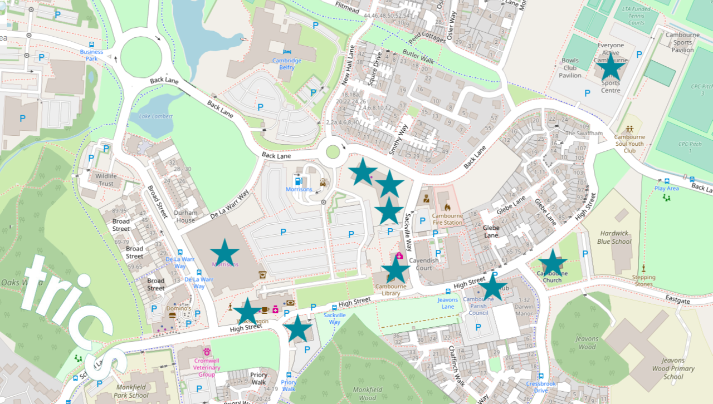
What to survey?

Slide 22
How to survey?
Standard TRICS survey specification not sufficient
Specifications require additional questions to deal with the internalisation aspect of the surveys

Slide 23
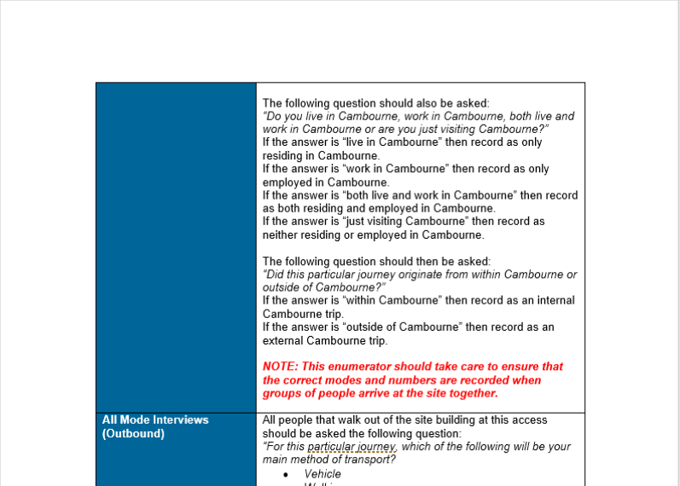
How to survey?

Slide 24
Through traffic
Site visits highlighted the certainty of through traffic
Eliminate traffic with ANPR cameras
Vehicles passing within 5 minutes were excluded
ANPR cameras to also record vehicles and vehicle occupants for both vehicular access points

Slide 25
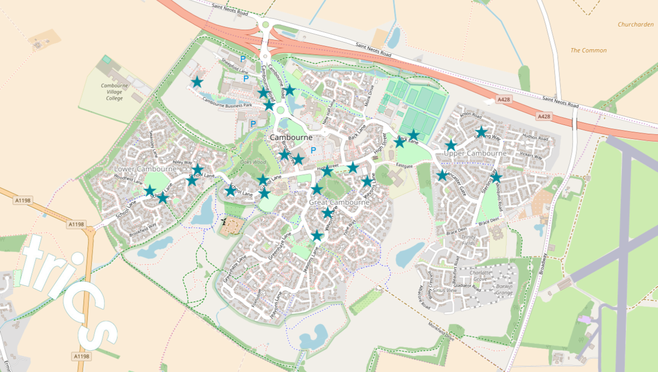
buses
Up to 10 buses per hour passing through the site
25 on-site bus stops
Not feasible to pace an enumerator at every bus stop
Place enumerators on buses as they pass through
Reduced required enumerators to 5
Interviews to determine internalisation levels

Slide 26
Putting the plan into action
Gather permissions to survey internal developments – usual strike rate around 1 in 3
Propose the surveys to TRICS data collection companies
Award and schedule surveys for one day
Notes:
Needed to get close to 100% to make the survey worthwhile and comprehensive
Assistance from local parish, district and county councils
The pub, Chutney Joe and Home Bargains would not give written permission
This left 7 on site developments to survey as well as the village

Slide 27
Awarding the surveys
Surveys split into 2 segments for tendering due to very large number of enumerators that would be required at the same time
QTS awarded the village, Morrison's and other retail park stores surveys
Alpha Parking awarded remaining 4 on-site development surveys
Notes:
once the tenders were awarded, we agreed a date with the 2 companies that would constitute a standard day in Cambourne
We then cleared the date with the parish council an prepared to carry out the surveys

Slide 28
Carrying out the surveys
Surveys took place on Thursday 7 June 2018 from 07:00 – 21:00
TRICS, QTS and Alpha Parking were all present on site
Weather and conditions were favourable
Over 30 enumerators in total on site for surveys
Some people refused to answer at multiple sites
Possible pre-survey awareness in future

Slide 29
The results
All surveys have been received and validated
Carried out some very initial observations of the survey results
TRICS has produced a spreadsheet of some of the data outputs of the surveys

Slide 30
CAMBOURNE VILLAGE: TECHNICAL ANALYSIS & PUBILSHED NOTE
The full survey results will be included in the next release of TRICS
New land use category – ‘New Communities’
Further interrogation of surveys
Final report to be produced by TRICS and placed in TRICS Library

